Slide 1

www.case-research.eu
Preparing for the Next Financial Crisis
Prof. Christopher A. Hartwell
Bournemouth University (UK) and Kozminski University (PL)
Fellow, CASE-Center for Social and Economic Research
4 June 2020

Slide 2
The Bad News
The next financial crisis is already here
Global economy was already heading for a recession in 2020
  Indicators throughout Europe were showing slowing growth and slack demand BEFORE March.
The COVID-19 pandemic and ensuing lockdown ensured that the recession’s arrival was hastened
The EU has very little ability to cushion the blow of the coming recession as policymakers are fighting the previous crisis
AND… Europe’s financial sector has become more fragile rather than more robust
  What does that mean for the future?

Slide 3
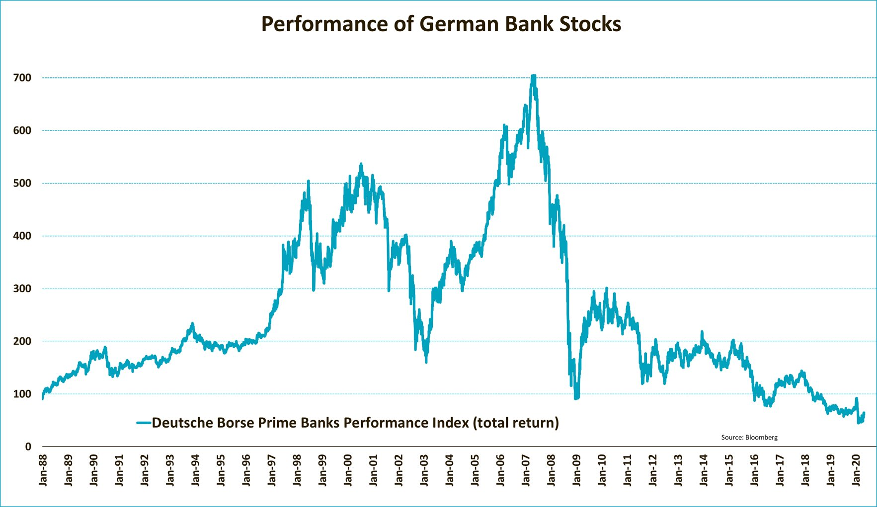
The Bad News

Slide 4
More Bad News
Higher capital ratios created “substitution out of retail-and-other-loan assets, and into risk-free, more liquid government bond securities” Naceur et al. (2018:8)
  Government bonds are not zero-risk (Hello Italy!)
  Have generated a similar risk profile across the world – uniformity when diversity is needed
Banks have shifted substantially from firm investment into consumer household loans
  Growth of 20% in Q4 2019 alone
As a result, house prices are hitting new highs across the euro area
22% growth
16% growth

Slide 5
The Good (ish) News
This crisis is being generated (mostly) exogenously because of the prohibitions on economic activity globally
Progress in the fight against the coronavirus pandemic and easing of restrictions (realization of trade-offs) will reveal how painful this has been for banks
The problem is that we cannot keep printing money and keep banks alive
  Especially now, the problem is not liquidity, it’s demand

Slide 6
The Way Out (Or, How I Learned to Stop Worrying and Love the Recession)
Analogy to the “forgotten Depression” in the US from 1920-21
  Sharp contraction in output
  Failure of several hundred banks
  Limited intervention by the government or the Fed (in fact, increase in interest rates)
  Output resumes once the post-WWI inflation is wrung out of the system
  Financial sector consolidates and focuses on core business

Slide 7



Dziękuję bardzo!
Thank you!
@CASE_research
CASE-Network
CASE – Center for Social and Economic Research

